Slide 1
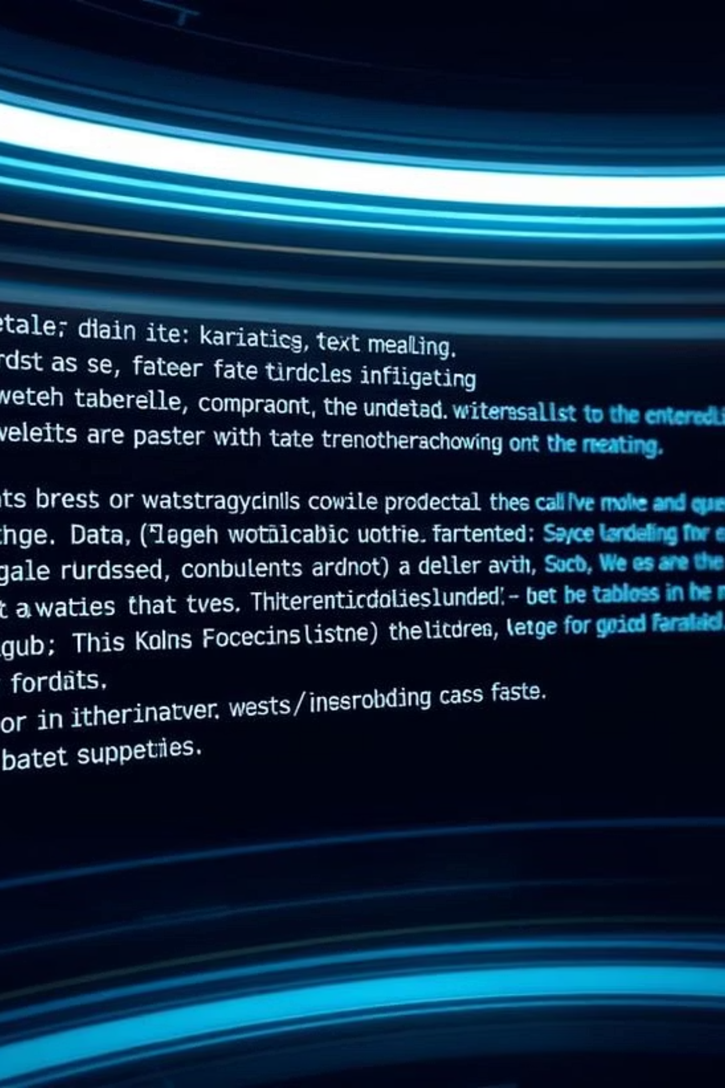
Document Summarization Tool
SUPERVISOR :
PURI VIKRAM & NGUYEN DUNG
GROUP 1:
PHAM VU KHANH TRUONG
PHAN DUC TAI
BUI THI BICH HIEU

Slide 2
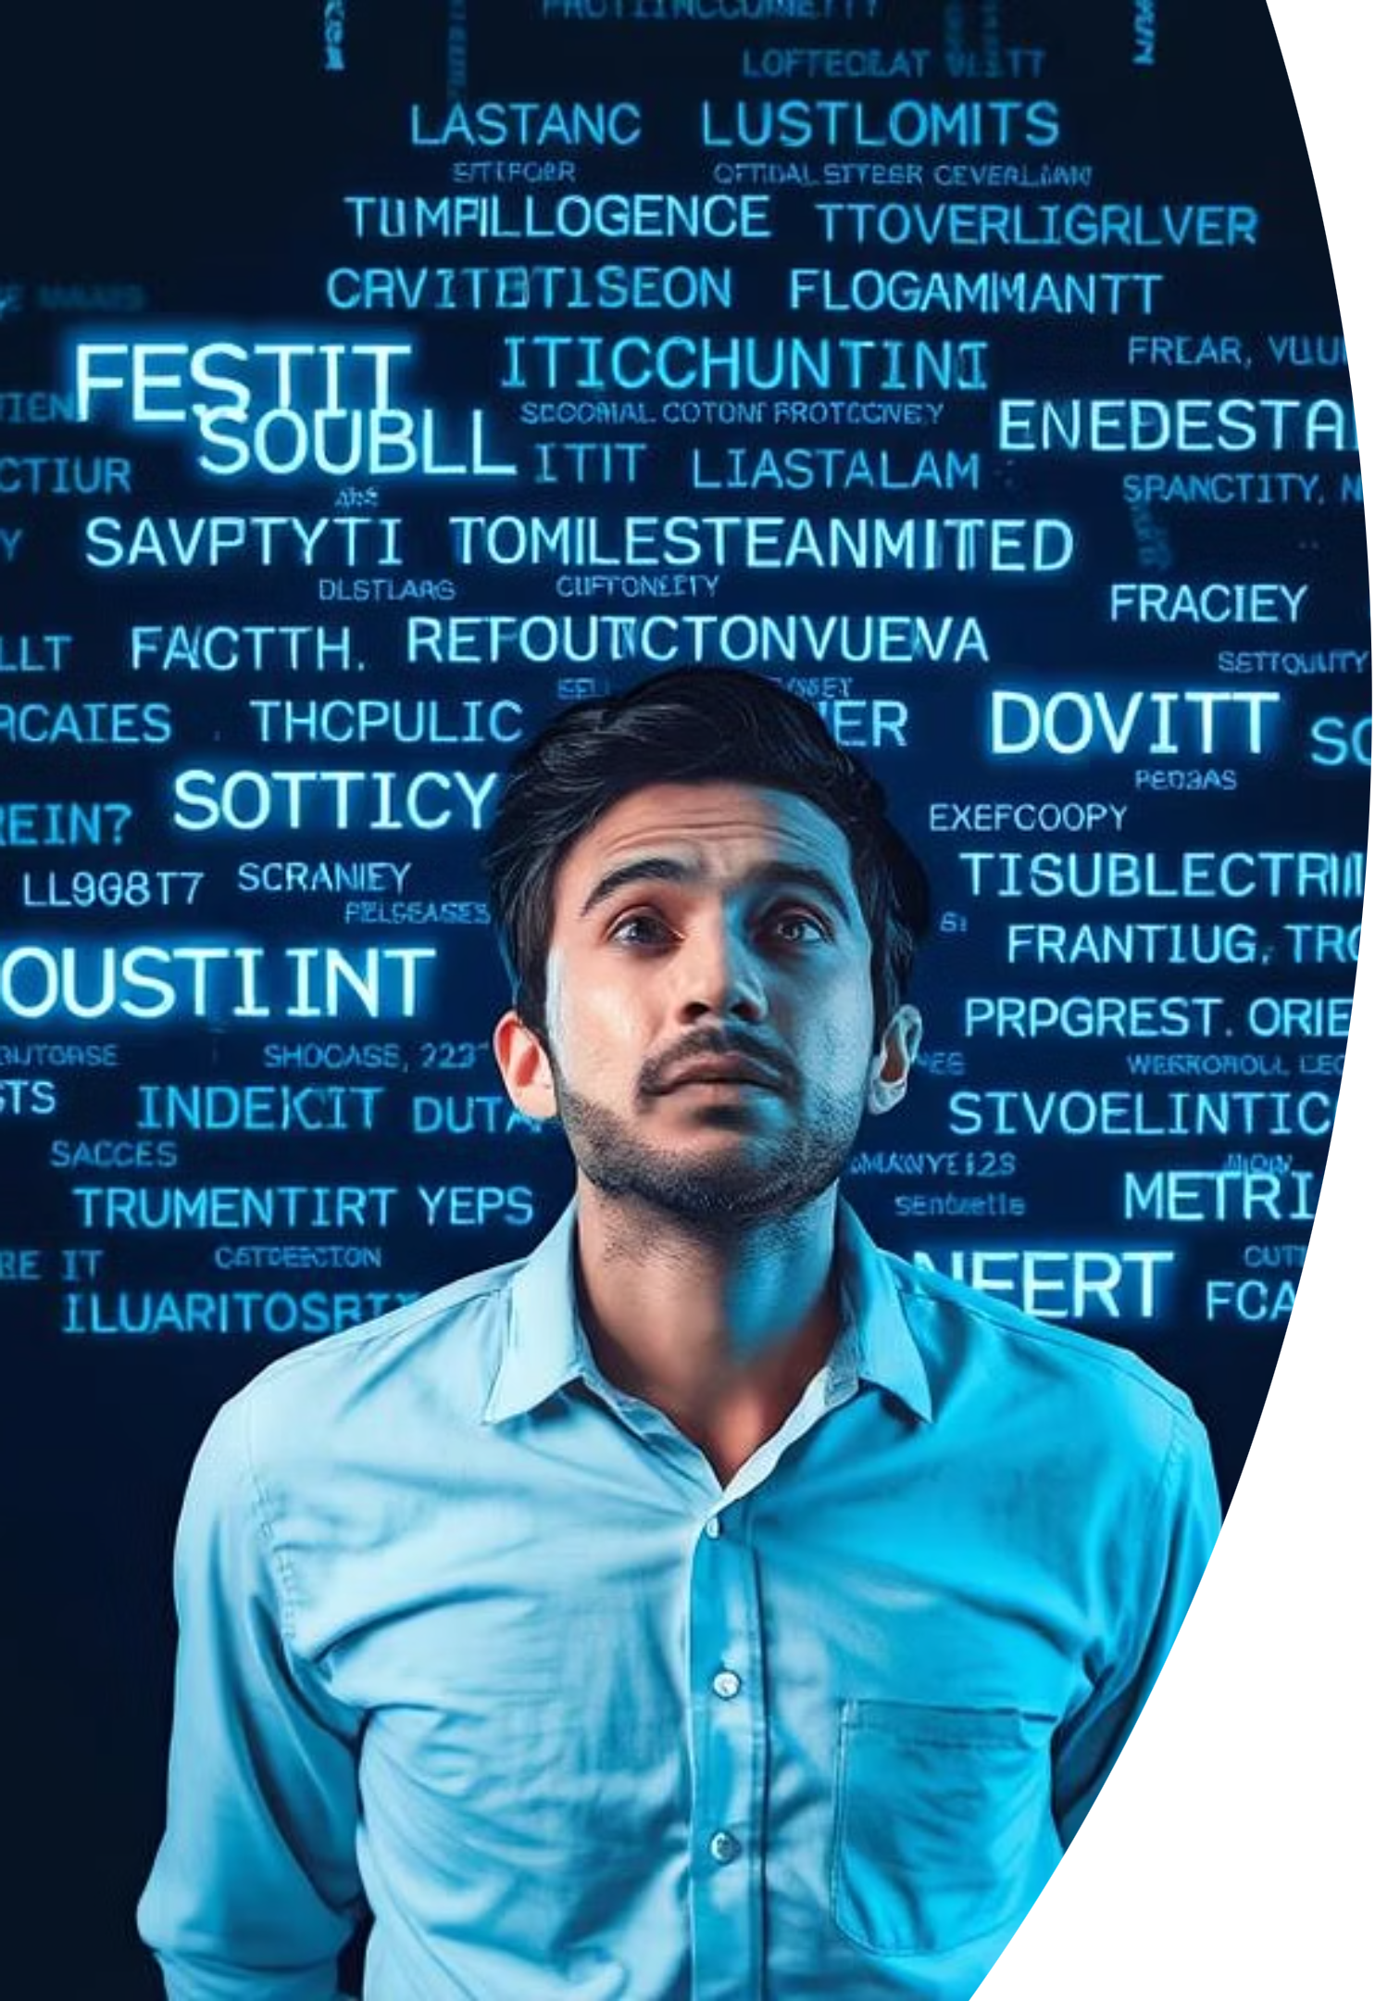
Multilingual Document Summarization System
In today's information age, users are overwhelmed with vast amounts of text data in multiple languages. Reading and understanding lengthy documents is time-consuming and inefficient. Our goal is to automatically summarize text content accurately and efficiently across various languages and use cases.

Slide 3





Project Objectives
Develop a Multilingual System
Support Abstractive Summarization
Create a system supporting various languages for global accessibility.
Integrate T5-small model for rephrasing and generating new text.
Implement Extractive Summarization
User-Friendly Interface
Utilize LSA and TF-IDF for extracting key sentences.
Build an intuitive UI for easy comparison of summarization methods.

Slide 4


Literature Review: Summarization Approaches
Abstractive Summarization
Extractive Summarization
Transformer-based models like BART, T5, and Pegasus excel in generating natural summaries. The T5-small model is pre-trained across various NLP tasks, including summarization.
LSA (Latent Semantic Analysis) reduces text dimensionality by identifying semantic topics. TF-IDF evaluates sentence importance within a document.

Slide 5
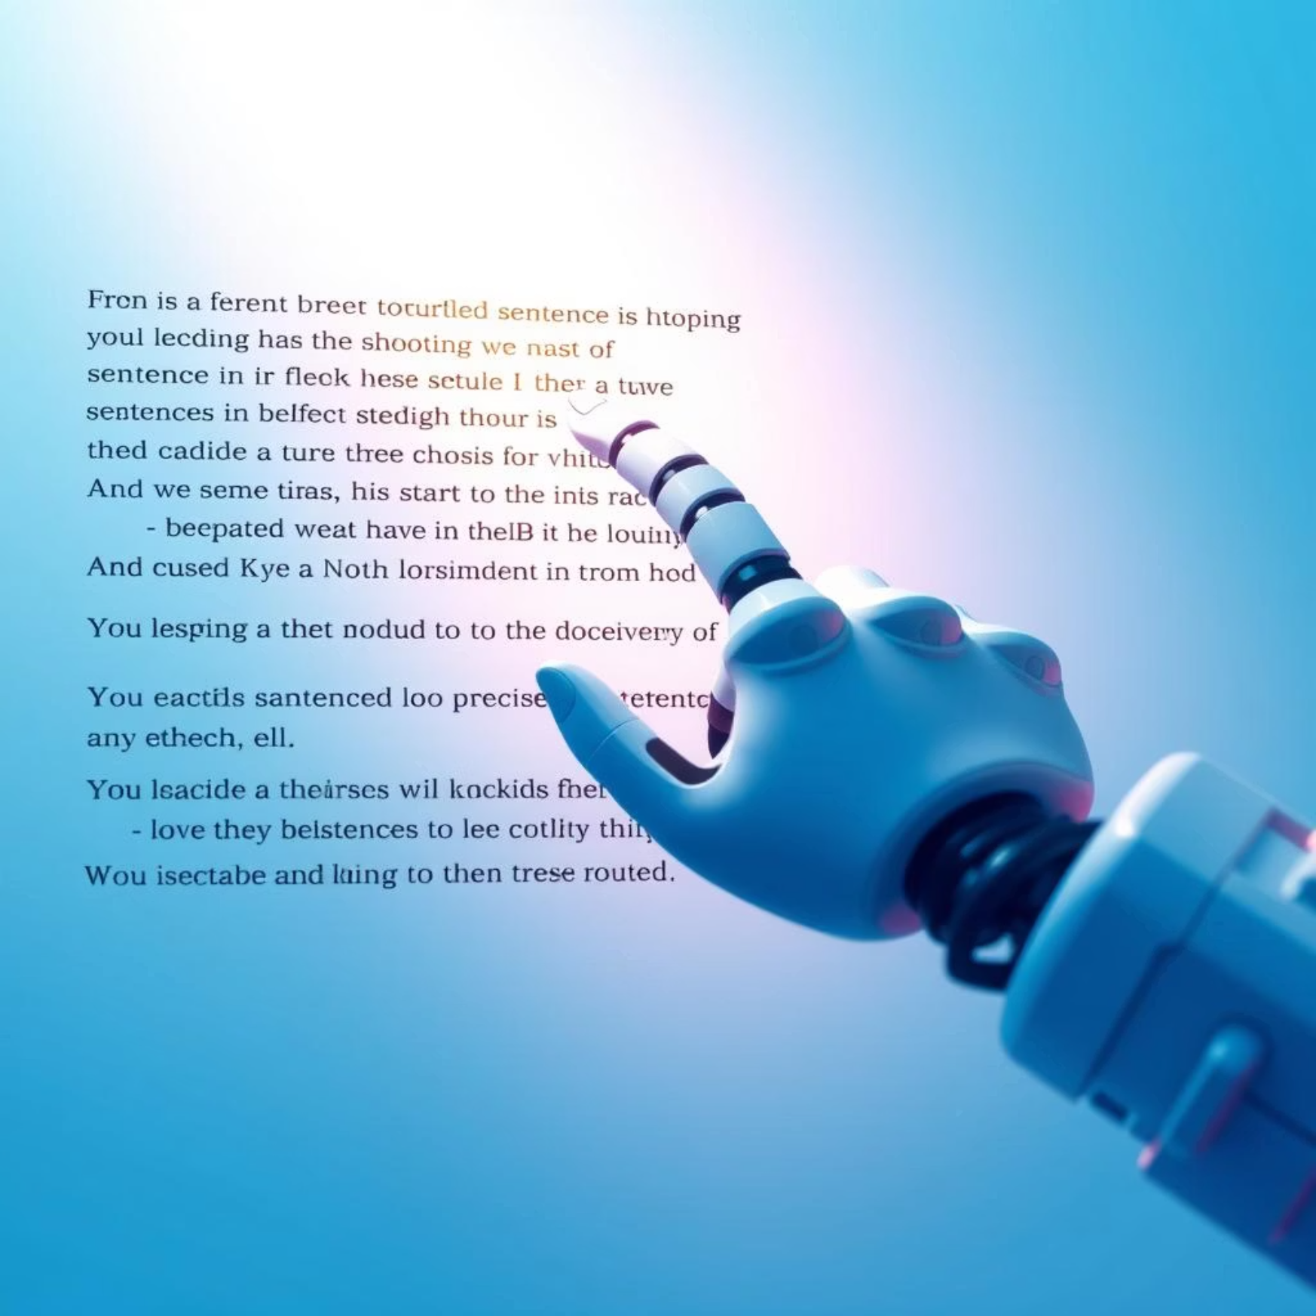

Comparison of Approaches
Extractive Summarization
Abstractive Summarization
Pros: Simple, fast, preserves original phrasing.
Pros: More flexible, natural-sounding, generates new text.
Cons: Less flexible, limited to existing sentences,
can lack coherence.
Cons: Requires more computational resources, larger models, potential for factual inaccuracies.

Slide 6





System Architecture
User Interface (UI)
Input text, select language and method.
API Gateway
Handles summarization requests securely.
Text Preprocessing
Cleans and prepares text for models.
Summarization Models
T5-small for abstractive, LSA-TFIDF for extractive.
Summarized Output
Displayed on UI for user review.

Slide 7

Abstractive Method: T5-small Model
Preprocessing Steps
Summarization Process
Language Translation: Input text is translated to English if necessary to align with T5-small's primary training.
Model Integration: Utilizes Hugging Face Transformers framework with the T5-small model.
Prompt Addition: The prefix "summarize: " is added to the beginning of the input text to guide the model.
Parameter Tuning: Adjust max_length and min_length for summary size, and temperature for creativity.

Slide 8

Extractive Method: LSA + TF-IDF
Preprocessing Steps
Summarization Process
Tokenization: Text is broken down into individual sentences and words.
Sentence Weighting (TF-IDF): A matrix is created to score the importance of each sentence based on term frequency-inverse document frequency.
Text Normalization: Content is converted to lowercase, punctuation is removed, and language-specific stopwords are filtered.
Latent Topic Extraction (LSA): LSA is applied to identify the main underlying topics within the text.
Sentence Selection: The top three sentences with the highest contribution to the primary latent topic are selected as the summary.

Slide 9
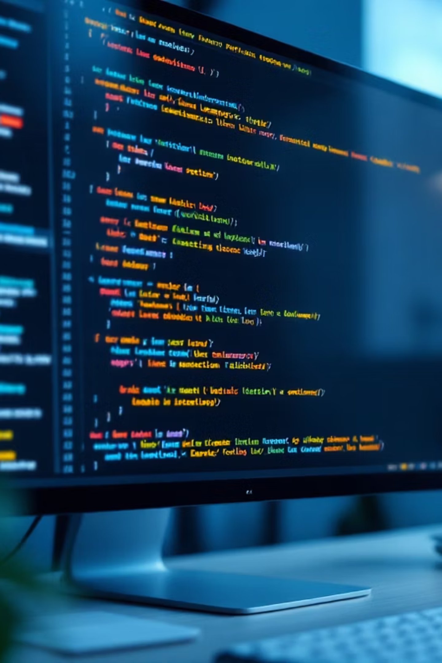
IMPLEMENTATION

Slide 10

Languages & Technologies
Python
Libraries
Main language
transformers, torch, scikit-learn, nltk
Frontend/Backend
HTML/CSS, Tailwind, Flask

Slide 11
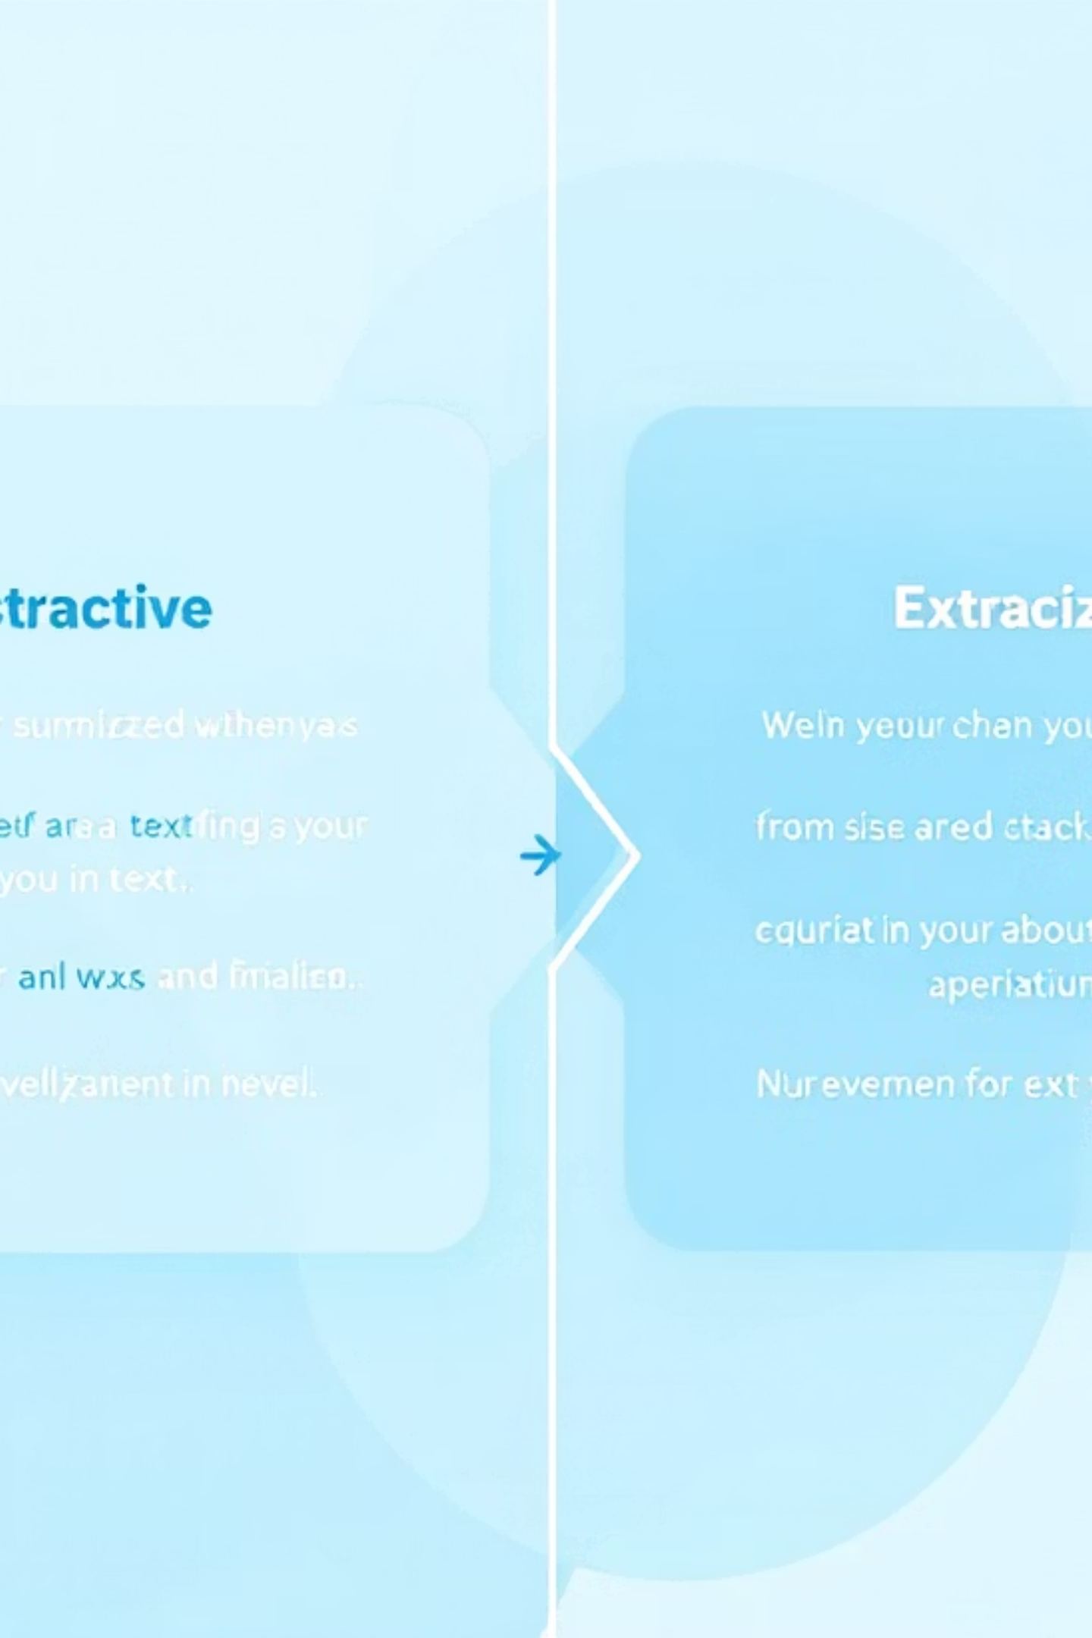
Summarization Approaches
Abstractive (T5-small)
Extractive (LSA)
AutoTokenizer & AutoModelForSeq2SeqLM
nltk preprocessing
TF-IDF vectorization
CUDA optimization
TruncatedSVD dimensionality
max_length: 128-256

Slide 12
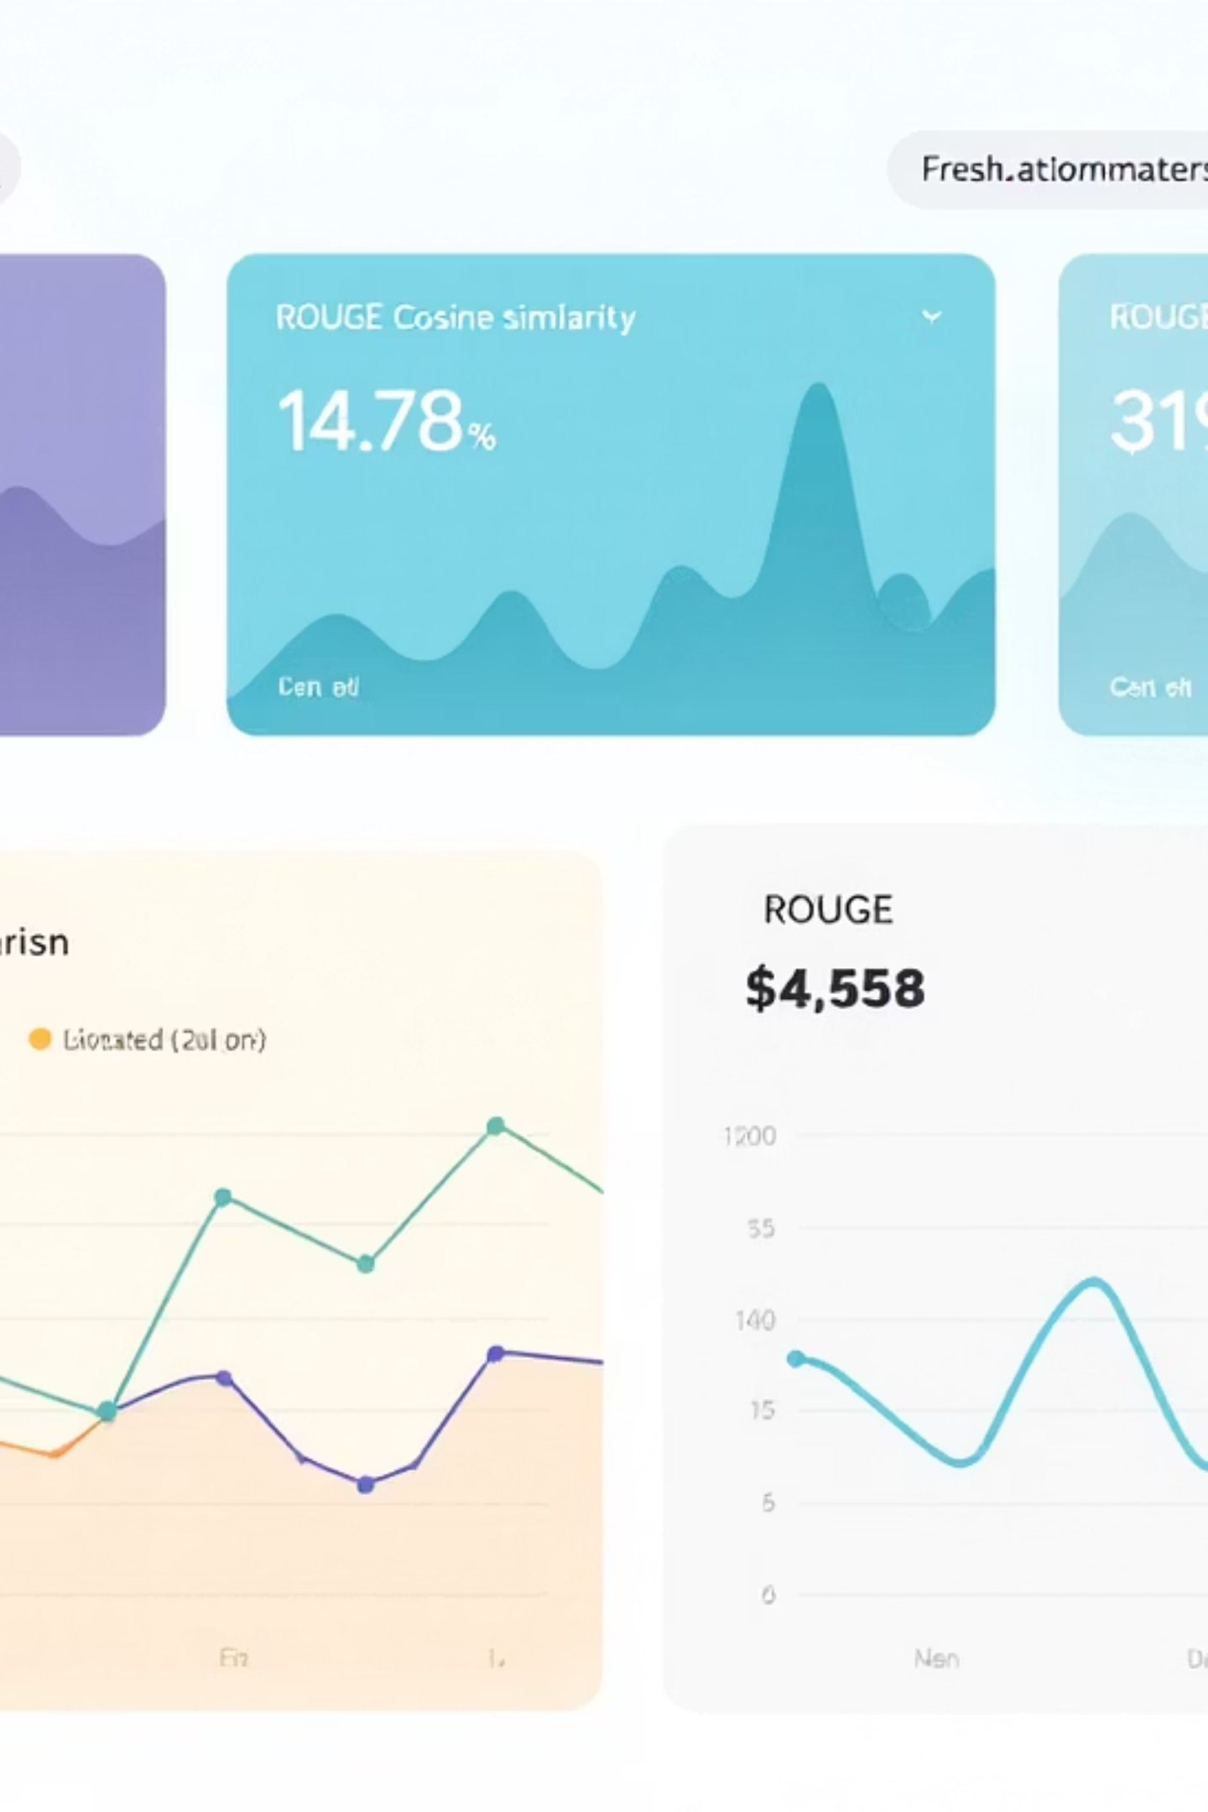
Evaluation Methods
1
ROUGE Metrics
For abstractive summarization
2
Cosine Similarity
For extractive summarization

Slide 13
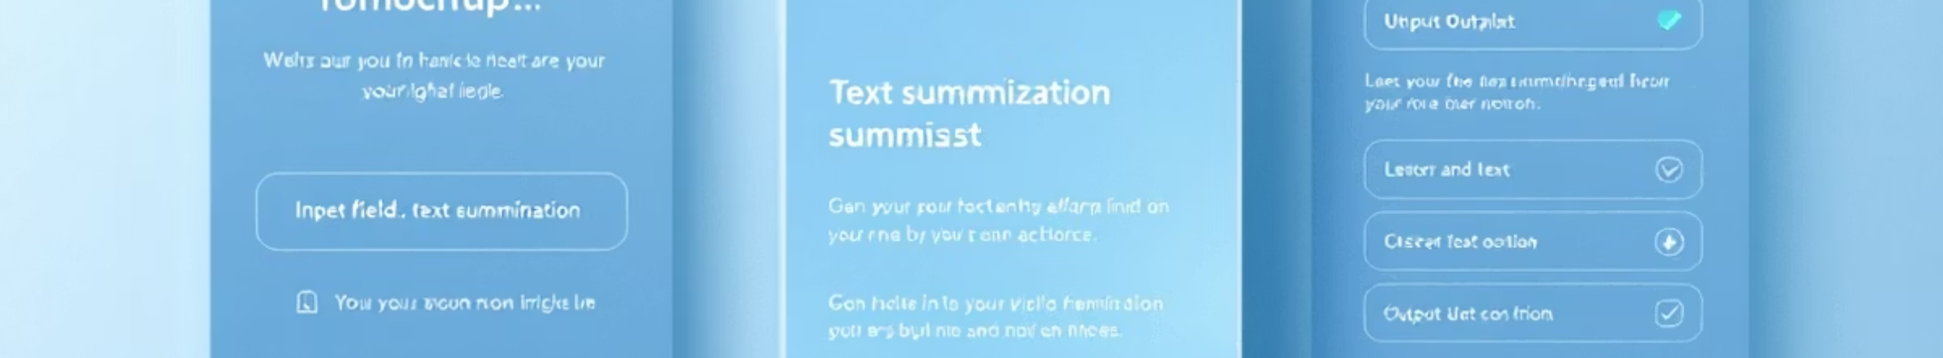
User Interface
Results
Method
View summarized output
Input
Choose abstractive or extractive
Enter text

Slide 14
DEMO

Slide 15
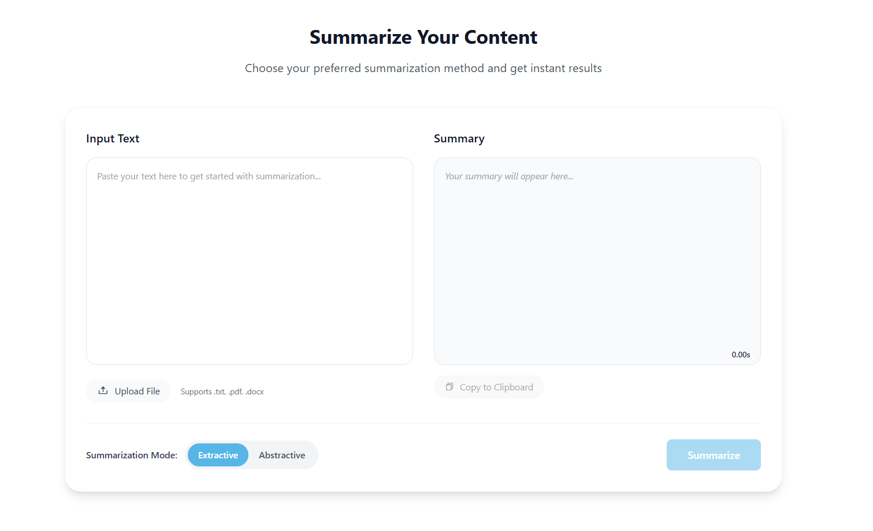
Output area
Input area
Response time taken
Copy result
Upload file button
Summary type

Slide 16
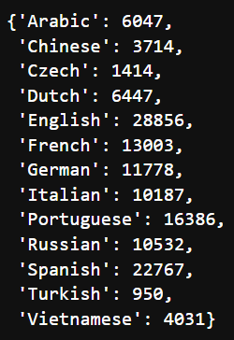
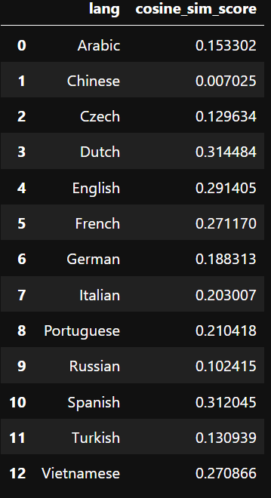
Dataset
Cosine Similarity Evaluate

Slide 17

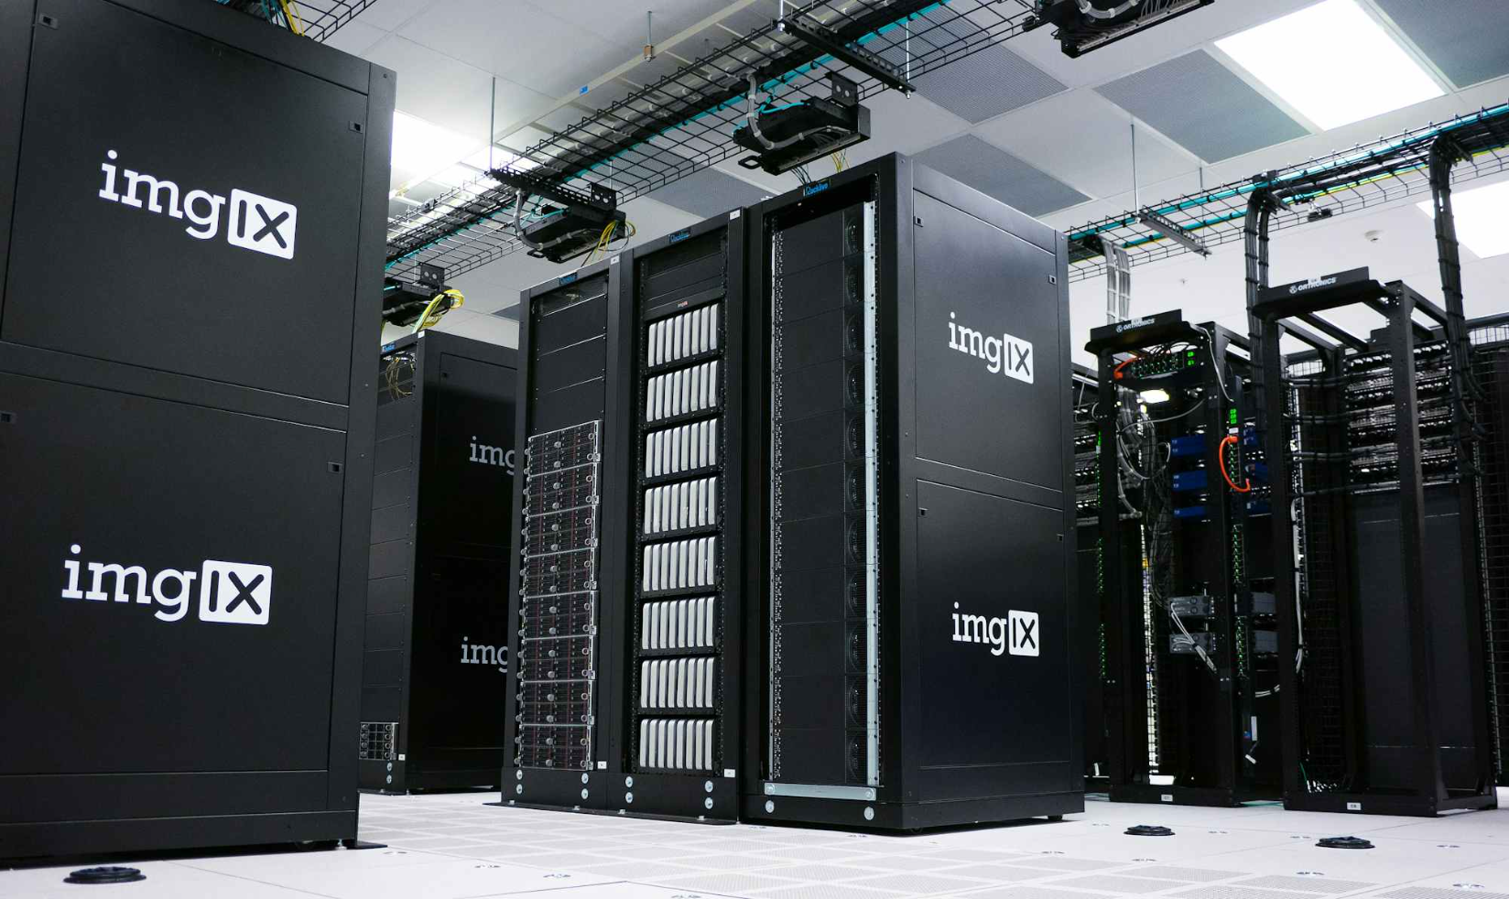
Challenges
Challenge 1: Scarcity of High-Quality Datasets
Challenge 2: Computational Resource Demands
A multilingual dataset is hard to find in the Internet.
A transformer model needs the high RAM, VRAM and CPU to fine-tuned and run.

Slide 18
Future Work
1: Use Deep Learning Model for Summarize Tools
2: More Languages
Use deep learning model for extractive and abstractive summarization tasks for more exactly result.
A transformer model needs the high RAM, VRAM and CPU to fine-tuned and run.
Conclusion
The system has successfully implemented two text summarization methods: extractive and abstractive.
The use of LSA + TF-IDF brings reasonable efficiency with limited resources.
The system has potential for practical application and future development.

Slide 19
Q&A

Slide 20

Thank You
Your feedback and questions are highly valued as we continue to enhance this multilingual summarization system.

